Slide 1
GA Data Science

Slide 2
Outline
A little bit of background
What was the hypothesis and problem statement
Exploratory analysis
The actual model
Applying the model to other datasets
How the model could be improved

Slide 3
Training a model to identify GCs
Globular clusters clumps of stars in the halo of galaxies
They are used to determine galaxy ages and how they formed
Identifying them is a long time consuming process normally done by hand and many assumptions

Slide 4
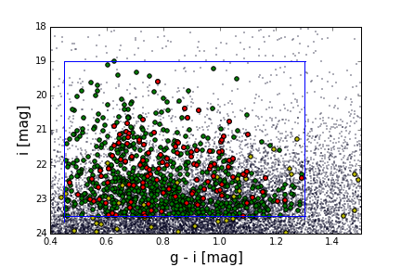
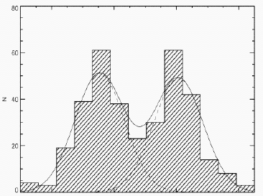
Basic project plan
Hypothesis :
Inferring GCs through training data and class them into their respective subpopulations
Data:
g [mag],r[mag],i[mag],sky coordinates
Test set:
244 confirmed GC*s as well as those objects that are not GC*s
V-I = 0.95 1.15
*GC stands for globular cluster
[Fe/H] = -1.5 -0.5

Slide 5
Exploratory analysis
Unfortunately training data was limited to three measurements of magnitude (g, r, i)

Slide 7
The model!
Using GC magnitudes to infer the probability of whether an object is a GC or not
Success is measured in how often the model can correctly identify a GC compared to the times it does not

Slide 8
GC systems are known to be bimodal

Slide 9
Using a Gaussian mixture model (GMM)
g-i

Slide 10
More applications
Having trained the model we tried it on data it had never seen before
The issue encountered was that the training model insufficiently covered all those instances a non GC object could be

Slide 11
Unsatisfactory results
g-i
g-i

Slide 12
How to improve the model
Having an overall larger training set
More sources especially non GC sources will increase how well the model can learn
With increased data we will be able to use its X and Y coordiantes relative to its host galaxy as a vairable in the model
Including more variables to fit
At the moment limited to three variables
Should include information about the objects light profile and size

Slide 13
Any Questions?

